Slide 1
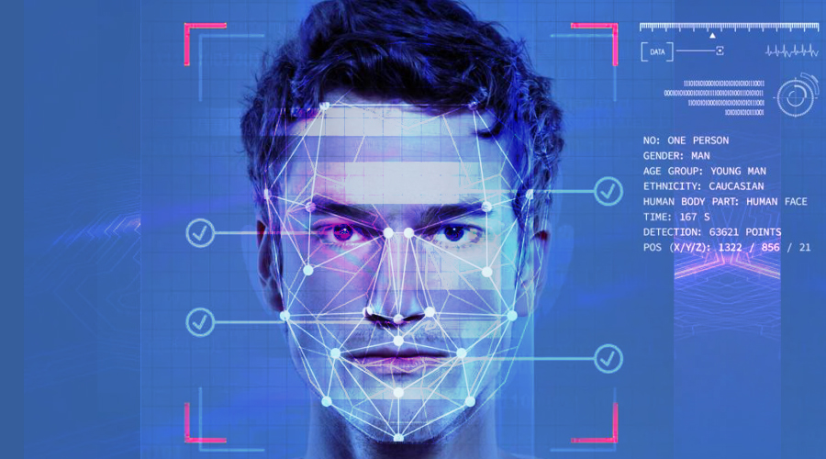
Intelligently Generate Images of Humans
—— Based On DragGAN and Stable Diffusion
Yifan Lin, Muhao Chen, Yifei Jiang
Group 4 2023-07-13

Slide 2


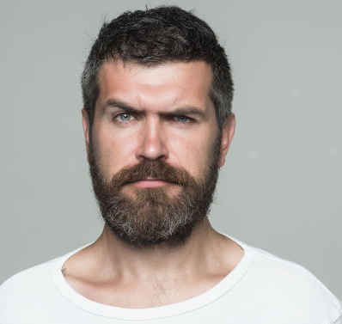


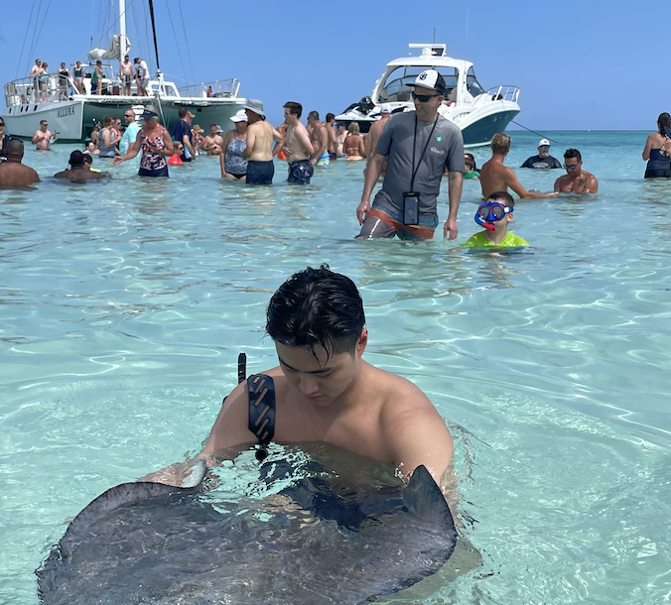
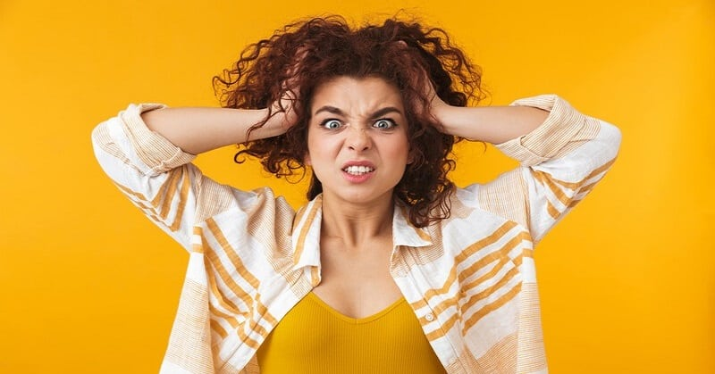
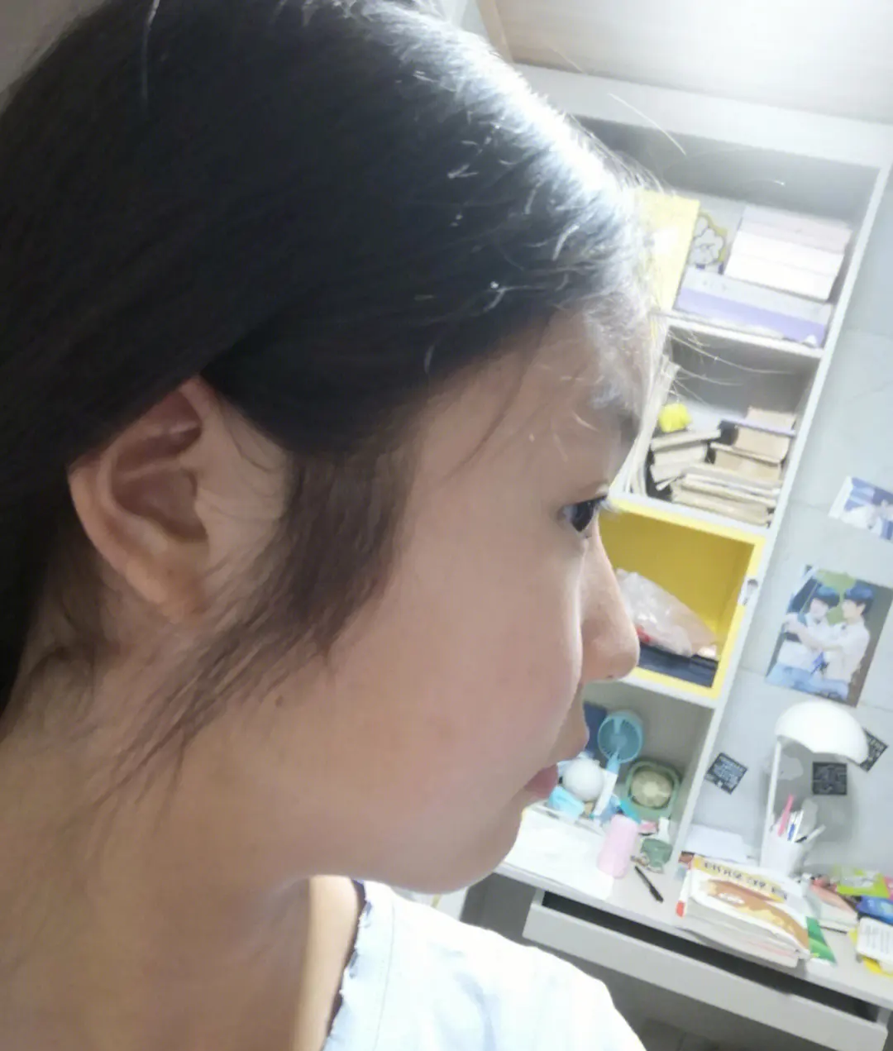
Business Problem Identification
Unsatisfactory Photos are making me ANNOYING
Main Factors
Inconsistent Body Positions
Unsatisfied Facial Expression
Unwanted Background Elements
Uncontrollable Environmental Factors
Selfie angle unsatisfactory

Slide 3
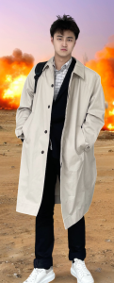
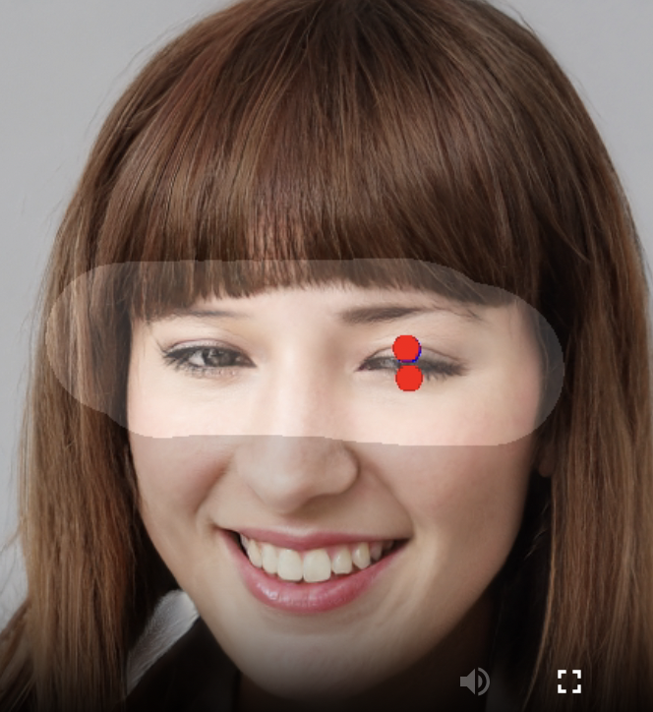
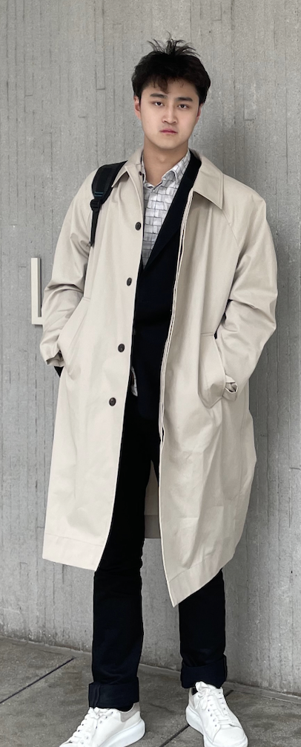
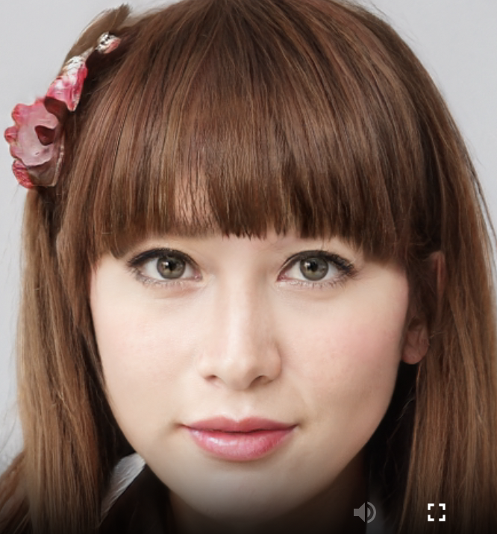
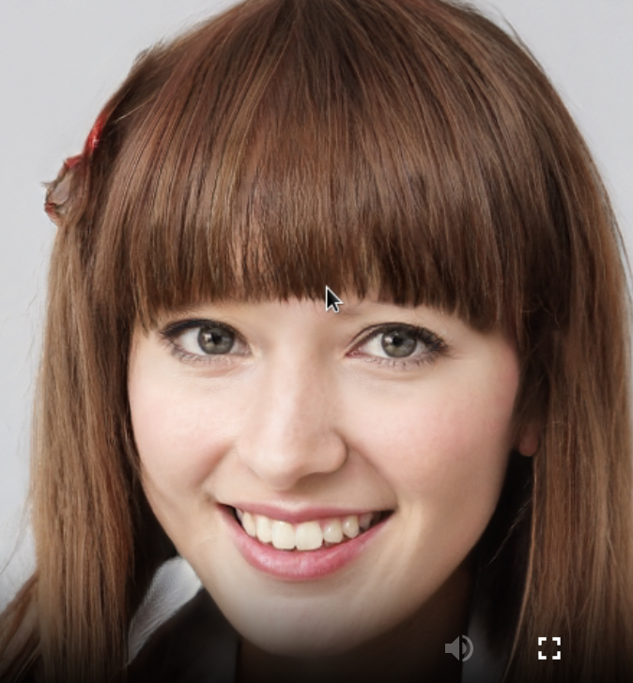





Solution Overview
Input
Preprocessing
Model
Grayscale conversion
CNN
Simple, Fast Train
Normalization
GAN
Background
Fairly Train (pixel)
Data Augmentation
DragGAN
Turn/Shape
flipping, rotation,
cropping, shearing
Text
High Pixel
Low Pixel
Stable
Diffusion
Expression
Asian Handsome boy
lying the bed with big eye.
Segmentation
Layout/Pose
AWS Storerage
AWS Computing
PhotoShop???
Generation!
Notes:
preprecessing:
https://www.section.io/engineering-education/image-preprocessing-in-python/

Slide 4
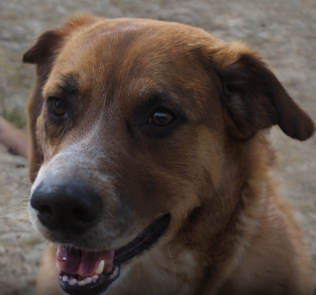
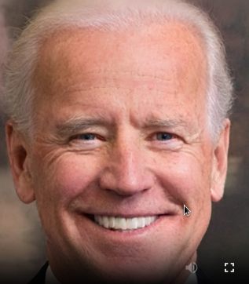
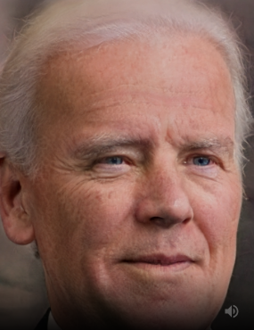


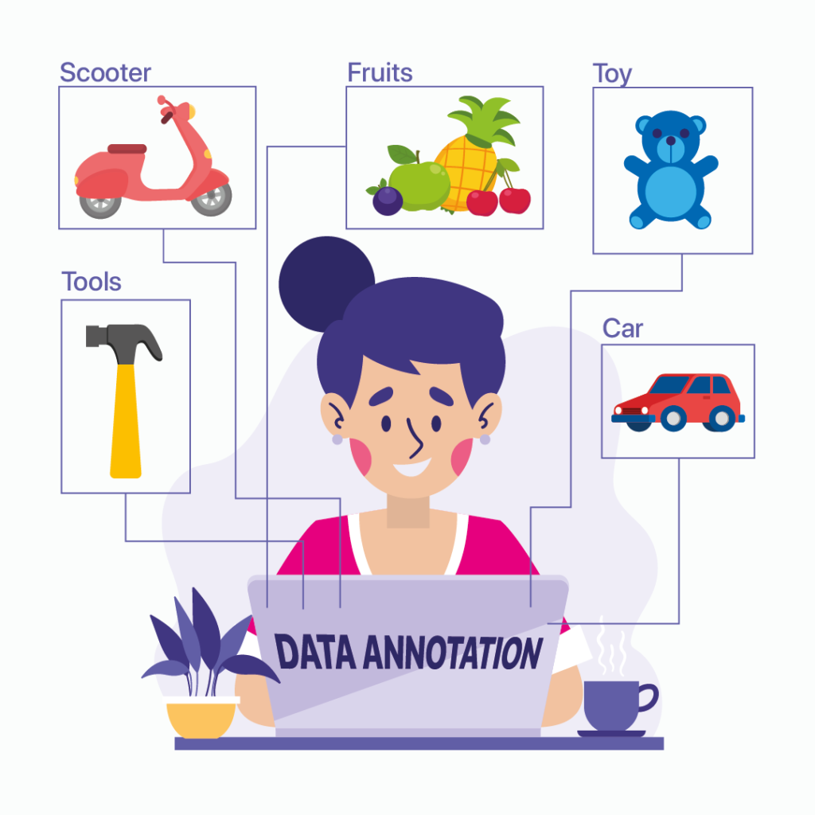
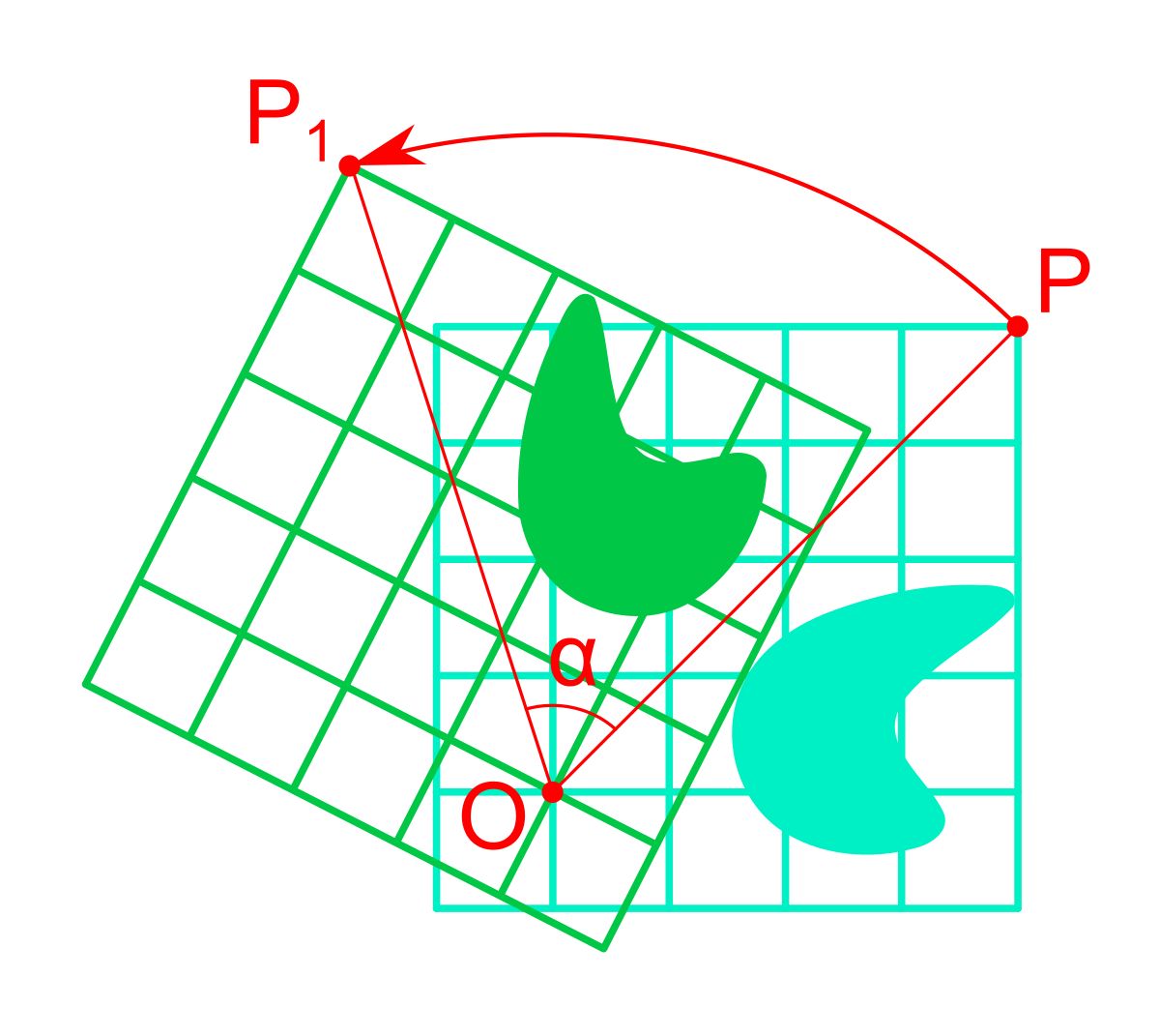


DataSet Description
Content
Esimate
Generalized
Human
S-Human
Text
Images
Command
Images
100GB + 10TB + 1GB
Text
A old man smiling with less white hair
10TB & 101GB
Collection
Business Benefits
Public
Payment
Manual
Gen+Adj
Multimodal
More Precise & Explanatory
Semi-Supervised
More Precise & Directional
Big Data
Generalization
& Personalization

Slide 5
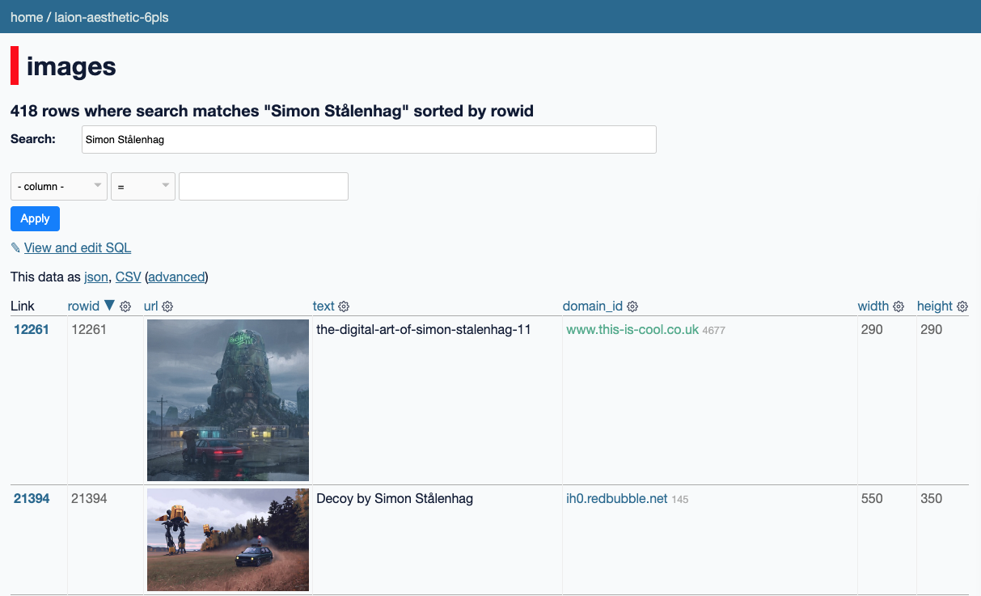
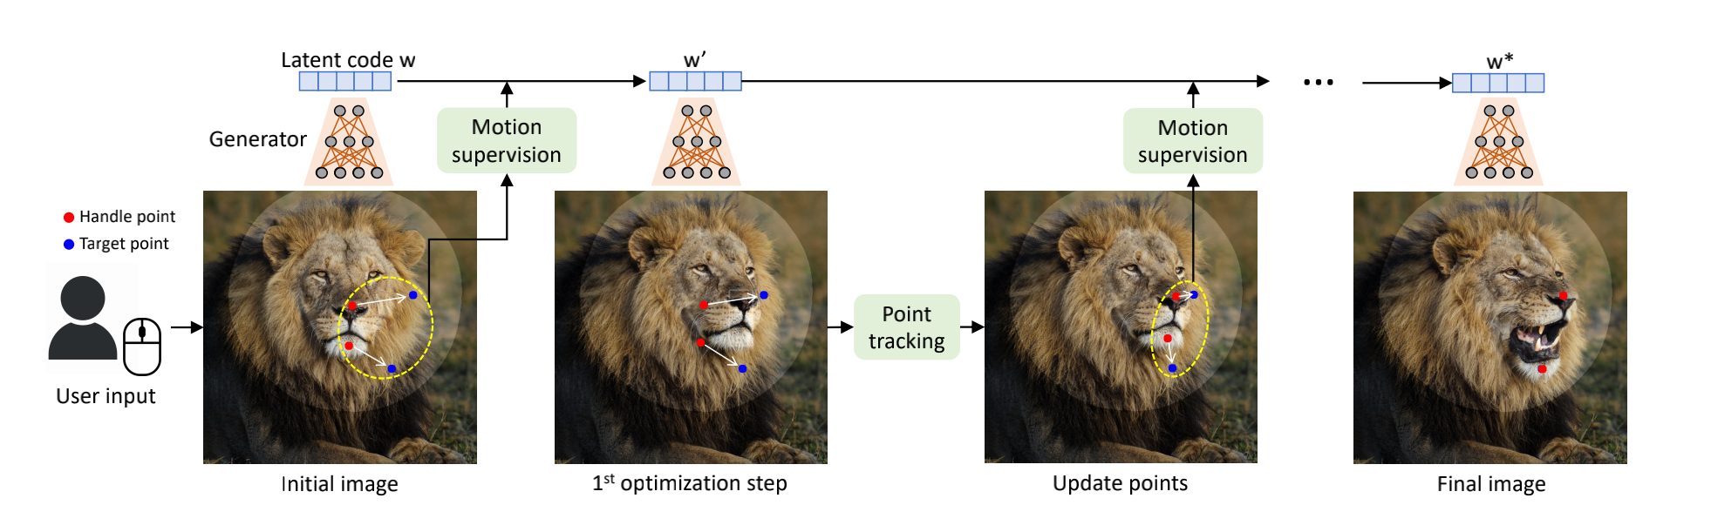
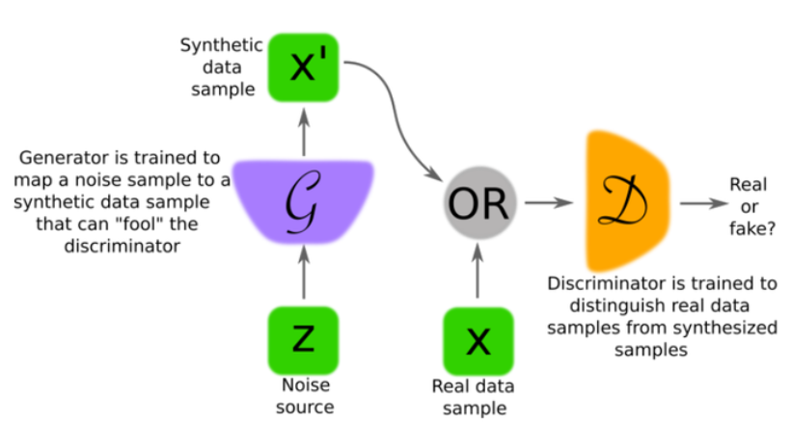
DataSet Understanding
Command
Points
Motion
Track
MultiModel
Images
Generate
Labeled
Unlabeled
Text
Noise
Data
Random
Text/
Command
Notes:
https://waxy.org/2022/08/exploring-12-million-of-the-images-used-to-train-stable-diffusions-image-generator/
https://laion-aesthetic.datasette.io/laion-aesthetic-6pls/images

Slide 6
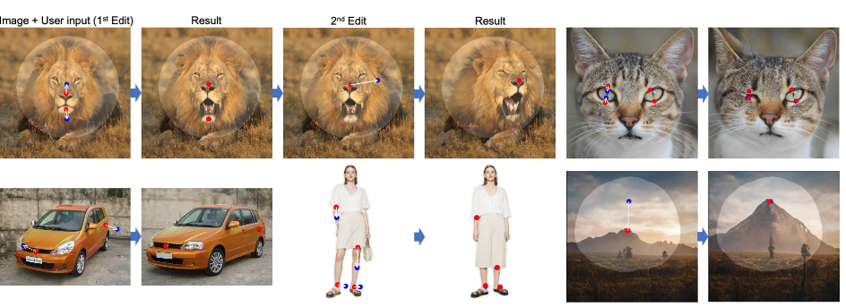
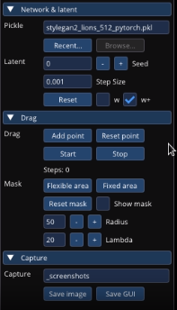
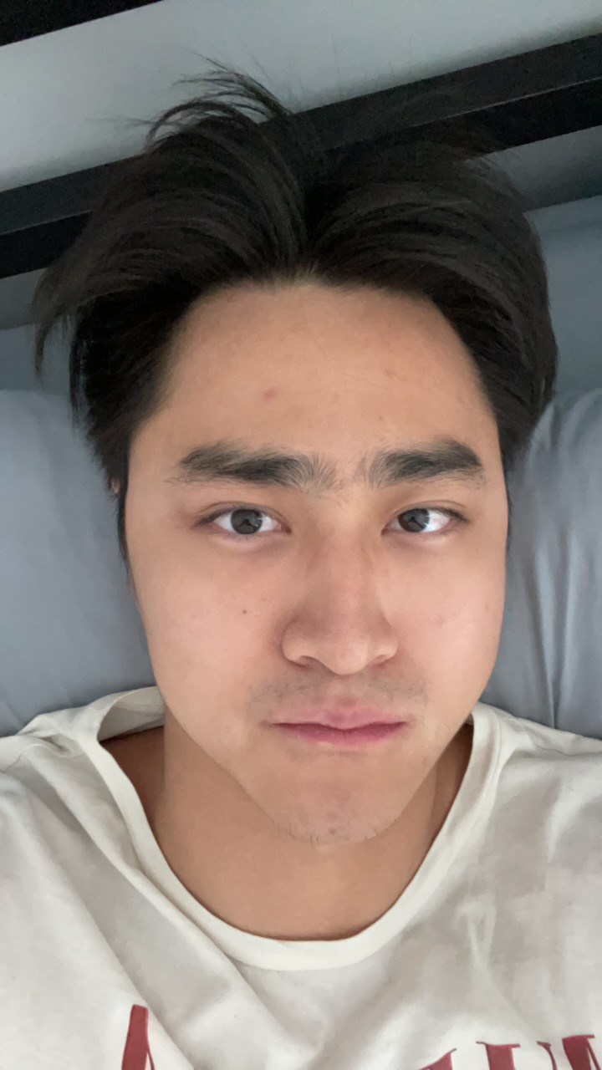
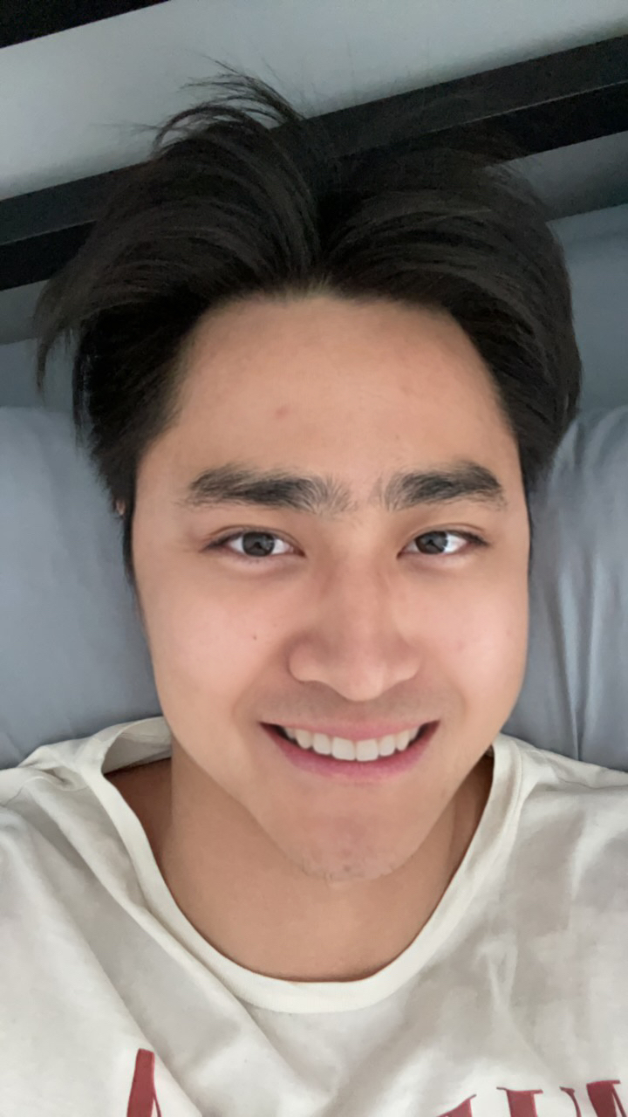
Methodology: DragGAN
Manipulation & Controllability
1
Select Point
Pose
Expression
2
3
Direction
Start/Stop
1
Shape
Layout
Select Mask
Next Step
Notes:
https://vcai.mpi-inf.mpg.de/projects/DragGAN/
https://github.com/XingangPan/DragGAN
https://github.com/zhaoyun0071
https://zeqiang-lai.github.io/blog/posts/ai/drag_gan/

Slide 7
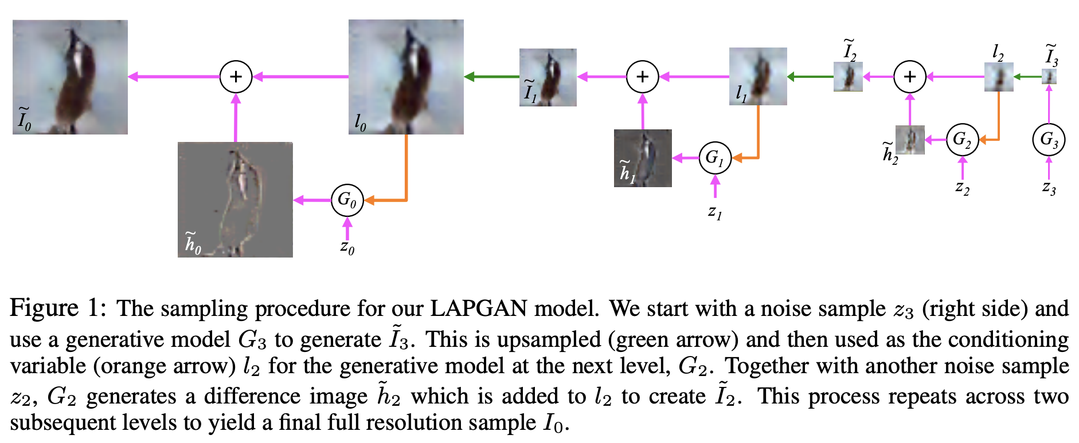
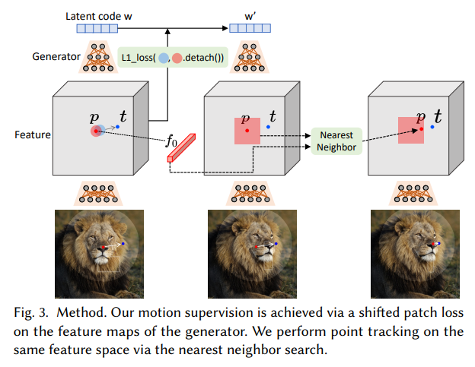
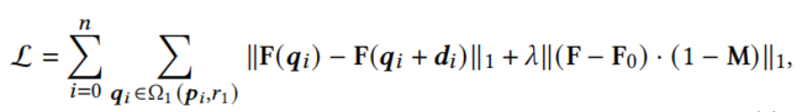
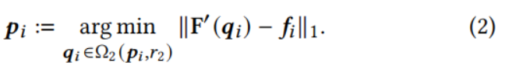
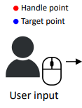
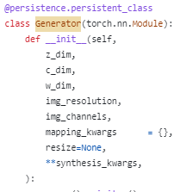
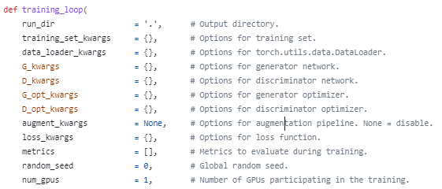
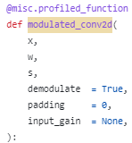
DragGAN Principle
GAN
Image Generation By Multiple GAN
Motion Supervision
Loss Function
Point Tracking
CNN
Generator
Training Parameter
Notes:
https://www.leiphone.com/category/yanxishe/tub6kY2SpdAXO77P.html
https://zhuanlan.zhihu.com/p/62746494
https://zhuanlan.zhihu.com/p/630910510
https://blog.csdn.net/weixin_45987920/article/details/105158483

Slide 8
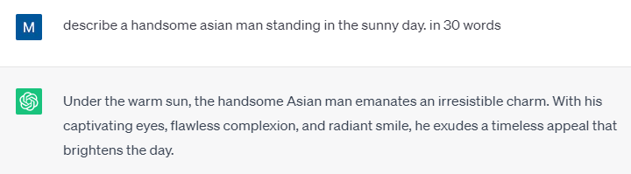
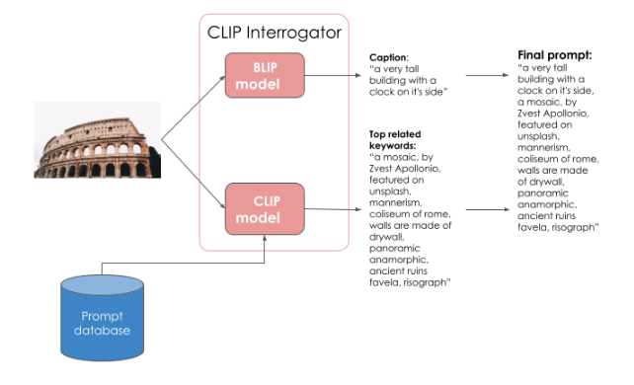
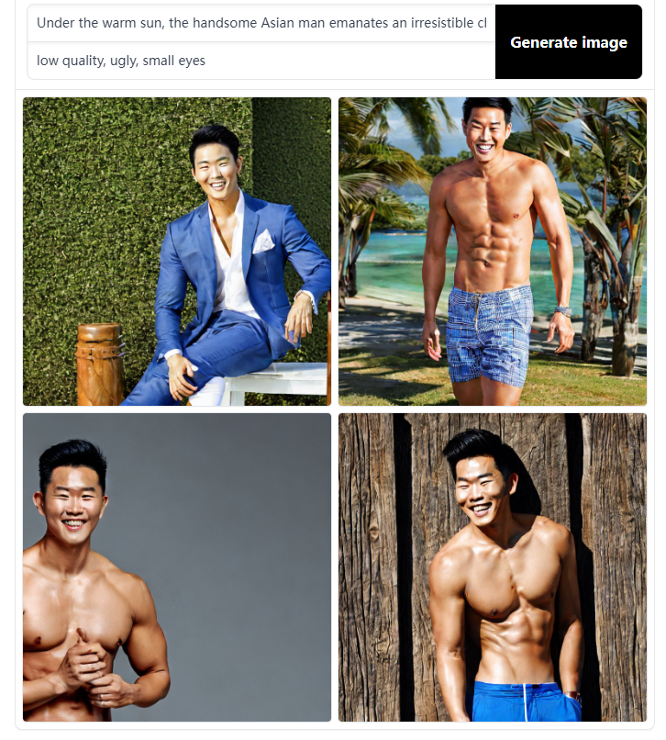
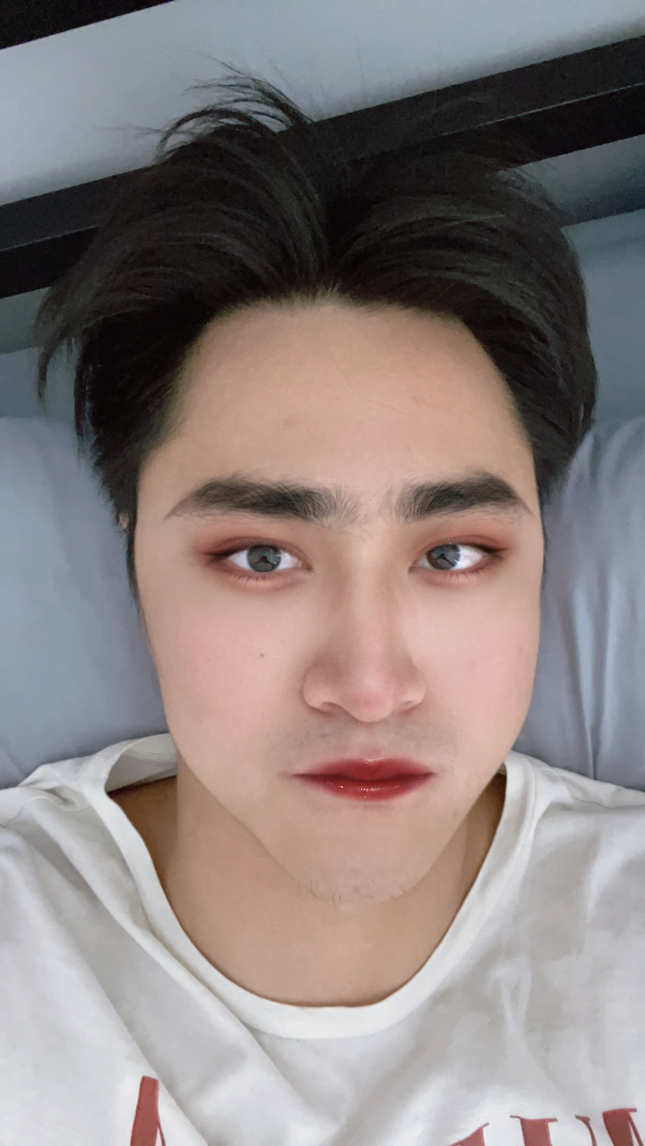
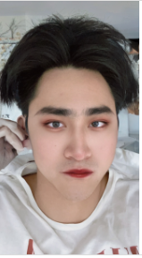
Methodology: ChatGPT + Stable Diffusion
Keyword
Prompt
Image
Image
Prompt
Suggestion
Original
Makeup
Background
Notes:
https://www.kaggle.com/competitions/stable-diffusion-image-to-prompts/code?competitionId=45917&sortBy=voteCount
https://www.kaggle.com/code/leonidkulyk/lb-0-45836-blip-clip-clip-interrogator
https://www.cutout.pro/photo-editing-background/upload

Slide 9
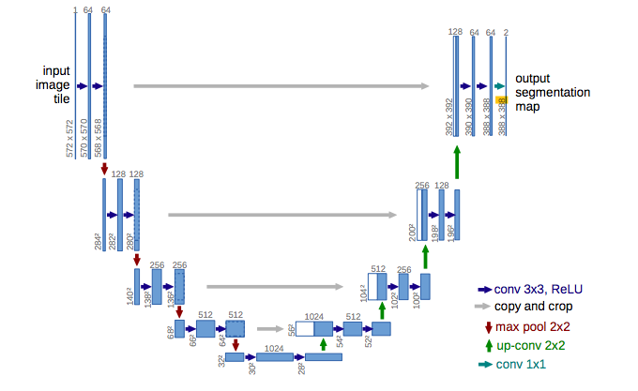
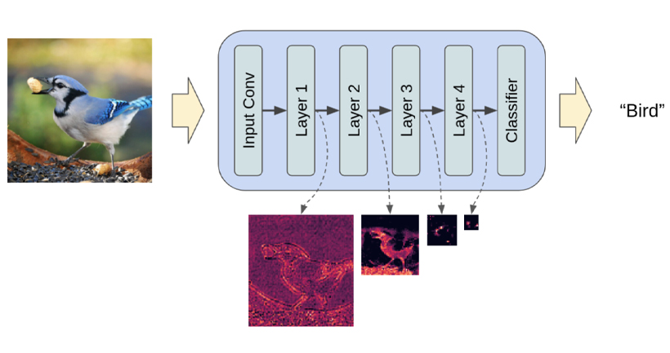
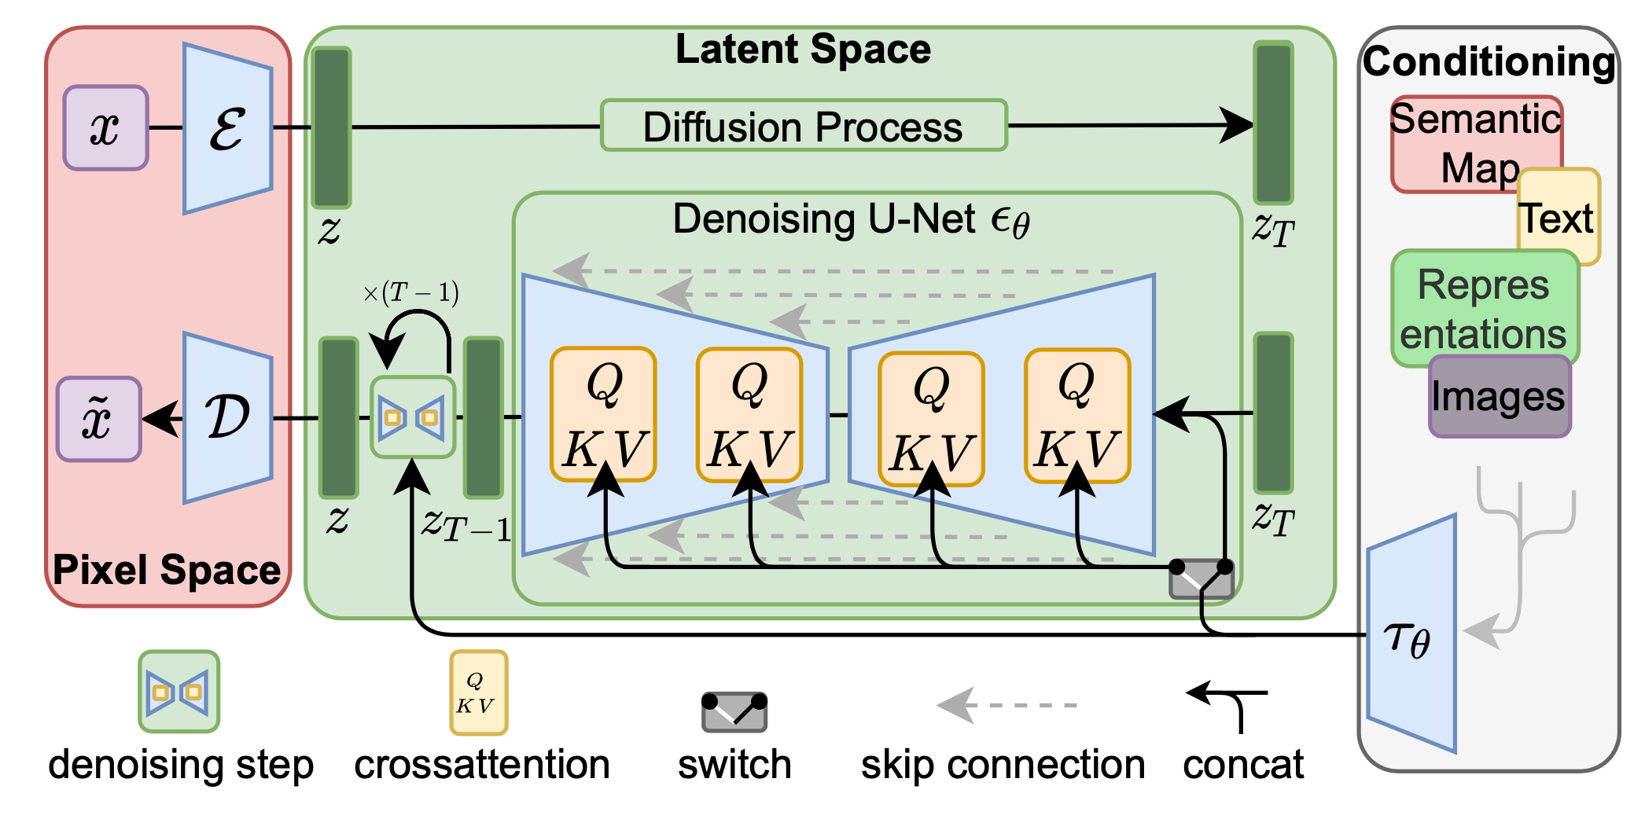
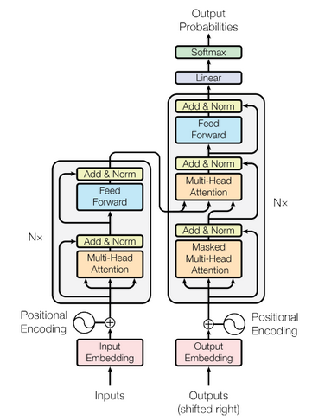
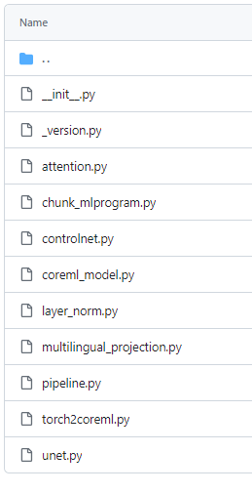
Stable Diffusion Principle
U-Net
Latent Space
Perceptual Compression
Semantic Compression
Input
Output
Component
Transformer
Notes:
https://www.kaggle.com/competitions/stable-diffusion-image-to-prompts/code?competitionId=45917&sortBy=voteCount
https://developer.aliyun.com/article/1215455
https://github.com/apple/ml-stable-diffusion/tree/main/python_coreml_stable_diffusion

Slide 10
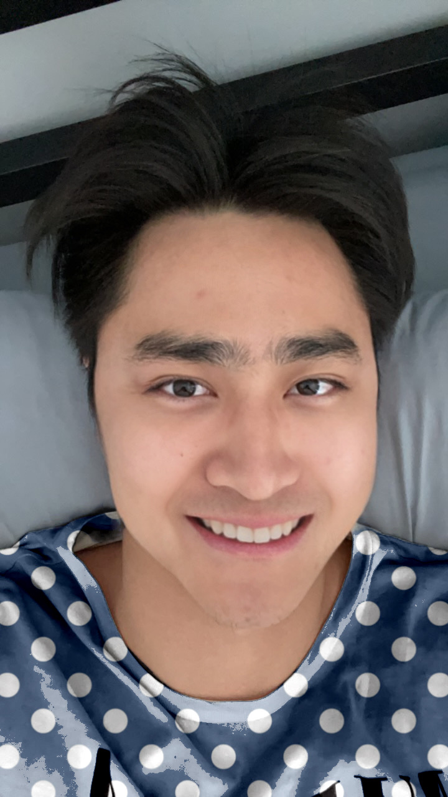
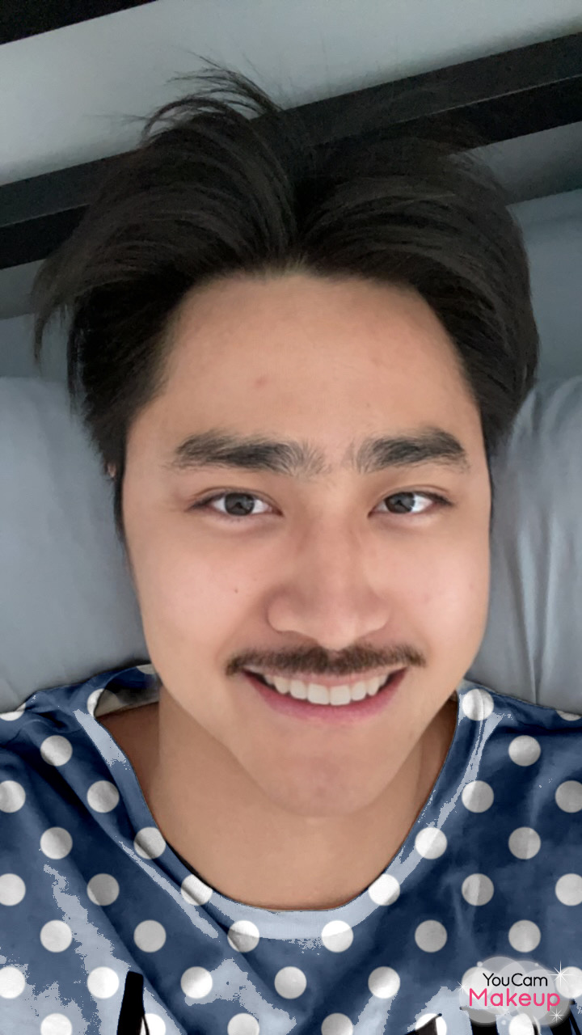
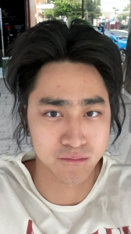
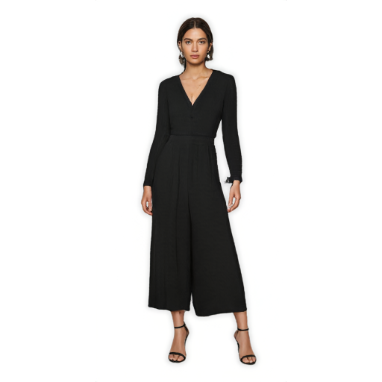
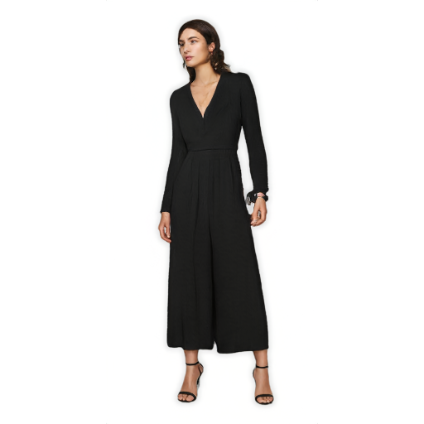
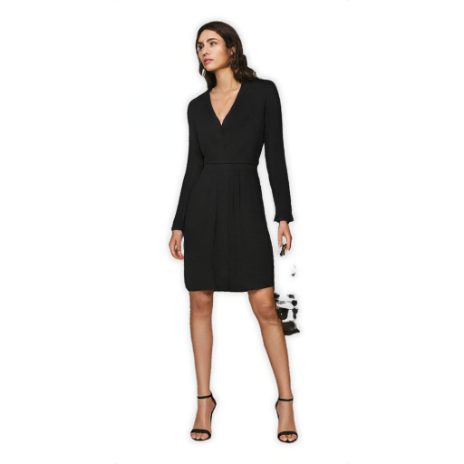
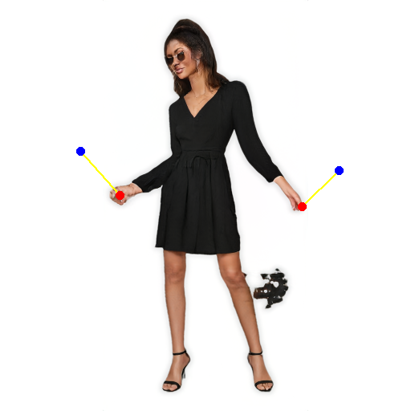
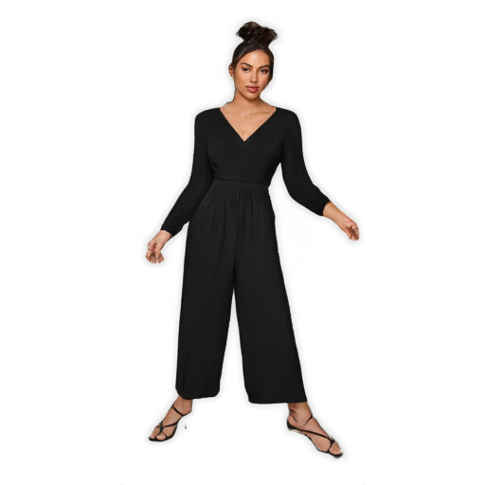
Result (Stable Diffusion & DragGAN)
make
smile
change
t-shirt
add
beard
change
back.
turn
head
shorten
skirt
open
arm
open
feet

Slide 11
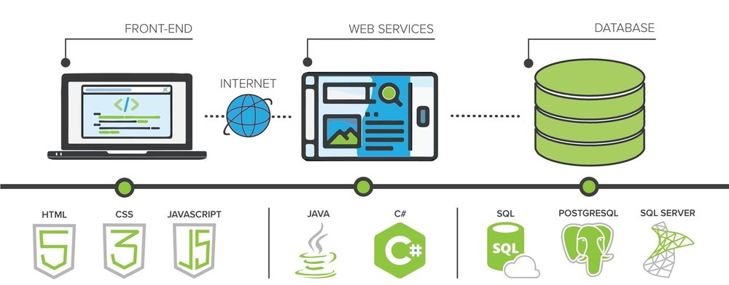
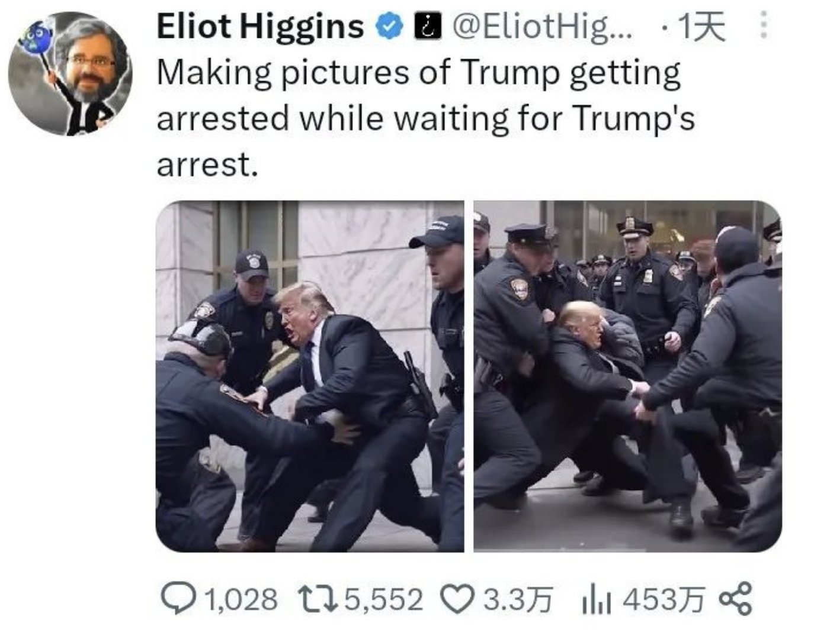

Implementation, Risk, Limitation and Improvement
Implement Architecture
Risk
Misinformation
Privacy Concerns
Biased Outputs
Offensive Content
Smart
Generation
Pre-Trained
Model
Image & Text
Personal
Adjustment
Generation On
Demand
Command
History
Improvement
Keyword Restriction
Privacy Detection
Limitation
Precise
API
Unification
Compute
Power
Generation Detection
GPU Acceleration

Slide 12
Reference
1. Pan, X., Tewari, A., Leimkühler, T., Liu, L., Meka, A., & Theobalt, C. (2023). Drag Your GAN: Interactive Point-based Manipulation on the Generative Image Manifold. arXiv preprint arXiv:2305.10973.
2. Rombach, R., Blattmann, A., Lorenz, D., Esser, P., & Ommer, B. (2022). High-resolution image synthesis with latent diffusion models. In Proceedings of the IEEE/CVF conference on computer vision and pattern recognition (pp. 10684-10695).
3. Creswell, A., White, T., Dumoulin, V., Arulkumaran, K., Sengupta, B., & Bharath, A. A. (2018). Generative adversarial networks: An overview. IEEE signal processing magazine, 35(1), 53-65.
4. Yi, X., Walia, E., & Babyn, P. (2019). Generative adversarial network in medical imaging: A review. Medical image analysis, 58, 101552.
5. Ledin, P., & Machin, D. (2020). Introduction to multimodal analysis. Bloomsbury Publishing.
6. Gauthier, J. (2014). Conditional generative adversarial nets for convolutional face generation. Class project for Stanford CS231N: convolutional neural networks for visual recognition, Winter semester, 2014(5), 2.

